Slide 1
Problem Statement:
Vehicle Cut-in Detection

Slide 2
Team
Team Name: Eureka
Intel Support: Amartya Saikiya
Faculty Mentor Name: Anand Achyutrao Barbind
Team Lead Name: Shukla Pranav Dipak
Member 2 Name: Hon Shantanu Pradeep
Member 3 Name: Deore Vaishnavi Satish
Member 4 Name: Gunjal Onkar Anil
Member 5 Name: Gawand Kunal Sharad

Slide 3
Vehicle Cut-in Detection
Category: Artificial Intelligence, Machine Learning, Deep Learning, Autonomous Driving
Participants: 1st to 4th Semester Students
Prerequisites:
Concepts in Machine Learning
Programming Skills (Python)
Deep Learning - Train/Validate/Test with Data

Slide 4
Vehicle Cut-in Detection
Description: Artificial Intelligence (AI) based machine learning (ML) techniques are widely becoming used and deployed in real-world applications. Autonomous driving is a technology that highly depends on a large volume and variety of data for training and testing. India Driving Dataset (IDD) is an open dataset, publicly available for research, and can be used for tasks like object detection and segmentation.
Outcomes:
Train a new ML model for detecting cut-in.
Use any extra data from other sources to augment training ML models.
Calculate the accuracy of performance in detection.
Create a 3-page report on the chosen problem, technical approach, and results.

Slide 5
Unique Idea
Overview
This project aims to develop a robust vehicle cut-in detection system using TensorFlow and OpenCV. The system processes image data to identify and predict cut-in scenarios, calculating critical metrics such as speed, distance, and time to collision to ensure timely and accurate responses.

Slide 6
Unique Idea
Solution Workflow
Data Preprocessing: Images are preprocessed using OpenCV techniques to enhance features and reduce noise, preparing them for model training.
Model Training: TensorFlow is used to develop a deep learning model that learns to identify cut-in events from the preprocessed images. The model is trained on the labeled dataset to recognize different vehicles and their trajectories.
Detection and Tracking: The trained model processes real-time video frames to detect vehicles and track their movements. OpenCV assists in tracking the position and speed of the detected vehicles.

Slide 7
Unique Idea
Calculating Metrics: Using the detected positions and movements, the system calculates:Speed: The relative speed of the cut-in vehicle.
Distance: The distance between the host vehicle and the cut-in vehicle.
Time to Collision (TTC): The estimated time before a potential collision occurs, based on the current speed and distance.

Slide 8
Features Offered by Vehicle Cut-In
Detection System:
1. Real-time Cut-In Detection
Immediate Identification: Continuous Monitoring:
2. Speed Calculation
Accurate Speed Measurement: Dynamic Adjustments:
3. Distance Estimation
Precise Distance Tracking: Safety Margins:
4. Time to Collision (TTC) Calculation
Collision Prediction: Proactive Alerts:
5. Traffic Behavior Modeling: Analyzes and models diverse traffic behaviors to improve detection accuracy.

Slide 9
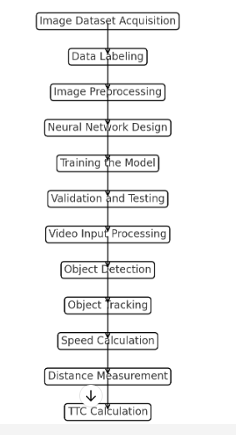
Flowchart of process:

Slide 10
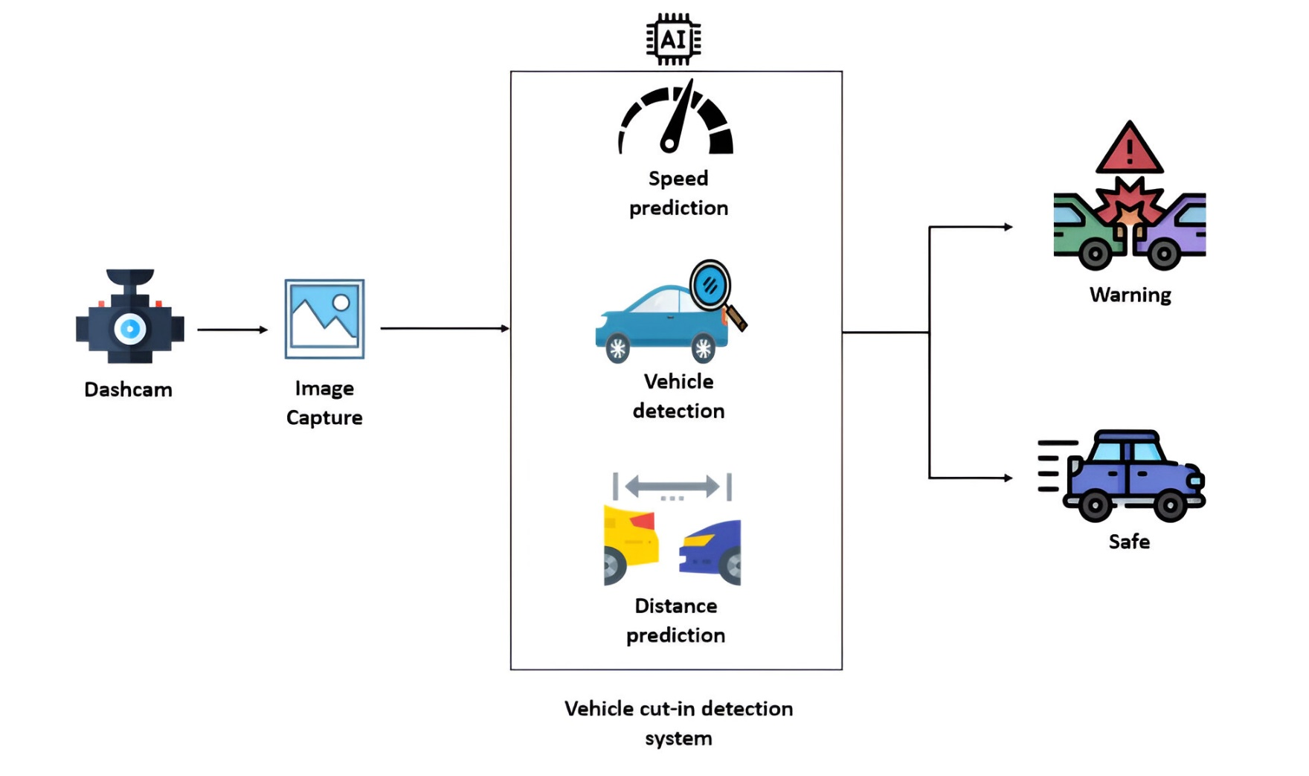
Architecture Diagram-Image

Slide 11
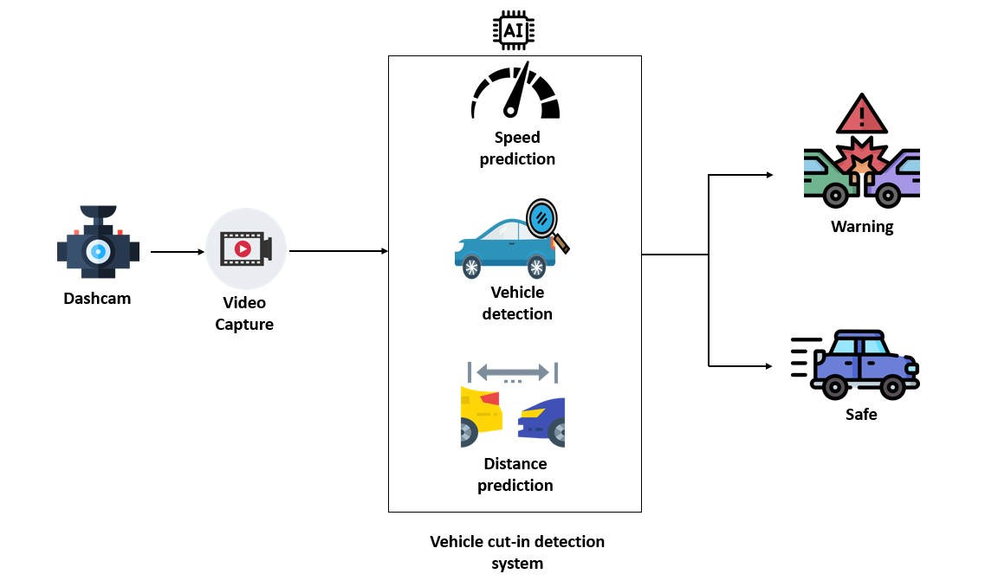
Architecture Diagram- Video

Slide 12
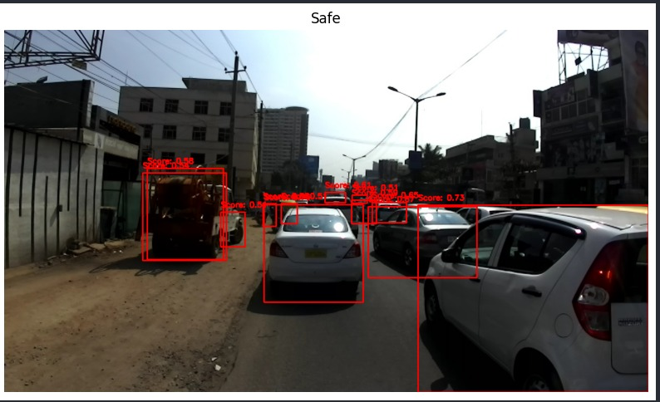
Output

Slide 13
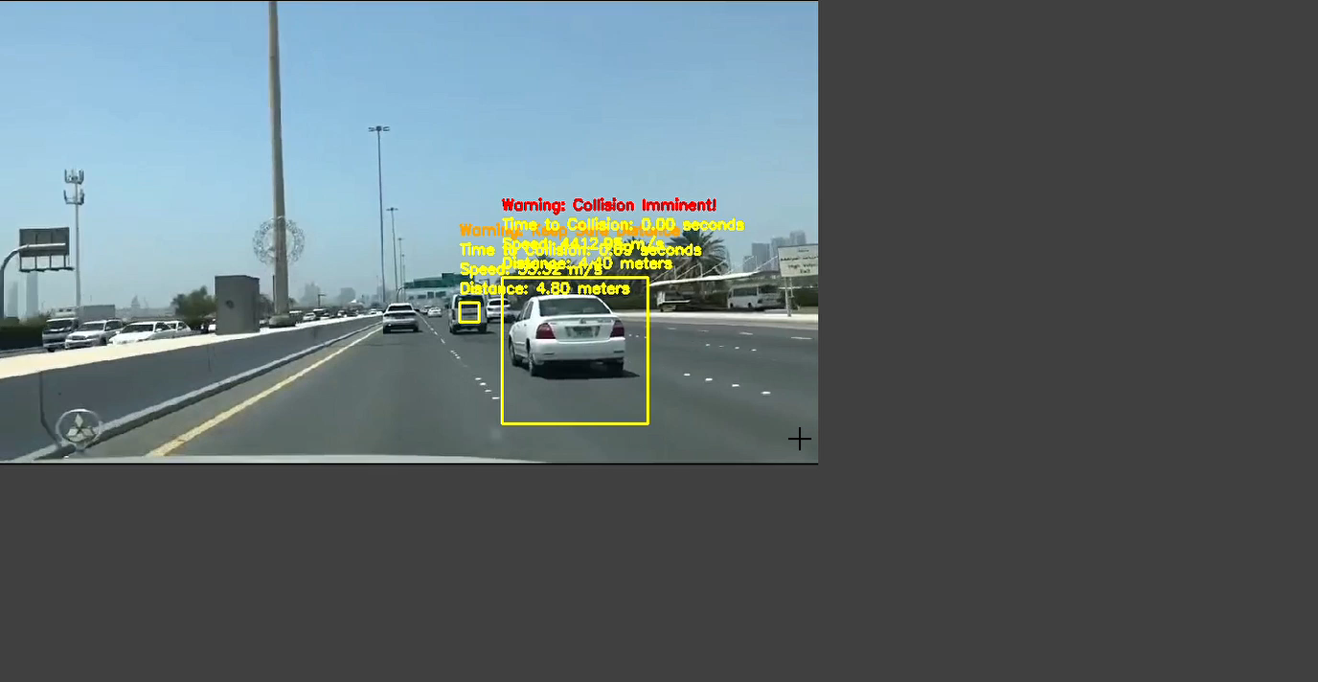
output

Slide 14
Technologies Used:
1. TensorFlow
Deep Learning Framework: Model Training: Flexibility and Scalability:
2. OpenCV (Open Source Computer Vision Library)
Image Processing: Feature Extraction: Real-time Processing:
3. Image Dataset
Labeled Data: Diverse Scenarios:
4. Python Programming Language
Versatility: Community Support:

Slide 15
Team members &Contribution
Team Members:
Pranav Shukla (Team Lead, SY )
Shantanu Hon (SY )
Onkar Gunjal (FY )
Vaishnavi Deore (FY )
Kunal Gawand (FY )

Slide 16
Contribution
1) Pranav: calculating vehicle speed and distance, deployment and testing the video and error solving in this project.
2) Shantanu: Code optimization and tensorflow image testing
3) Vaishanavi :Finding video and detection of car
4) Onkar: Finding dataset , cleaning dataset, image processing using open cv, image detection using tensorflow
5)Kunal: Using tensorflow calculate speed and distance for an image

Slide 17
Conclusion
In conclusion, the project successfully addressed the problem of detecting cut-ins by leveraging deep learning techniques on the IDD Temporal dataset.
The developed model shows potential for application in real-world scenarios to enhance driving safety and assist in autonomous driving systems.
Further refinements and enhancements could include incorporating additional datasets for further training and exploring advanced CNN architectures for improved accuracy and speed.

Slide 18


